Slide 1

BTC Price Prediction
BTC Price Prediction
Roll | Name | Exam Seat no
82 | Vedant Dawange | T214058
159 | Uddhav Patil | T214148
1

Slide 2
About Bitcoin:
BTC Price Prediction
Bitcoin (₿) is a decentralised digital currency that may be sent from user to user on the peer-to-peer bitcoin network without the use of intermediaries.
It has no central bank or single administrator. Network nodes use cryptography to verify transactions, which are then stored in a public distributed ledger called a blockchain.
A few local and national governments are officially using Bitcoin in some capacity, with one country, El Salvador, adopting it as a legal tender.
2

Slide 3
Structure:
BTC Price Prediction
Yahoo finance API- to get the daily price of Bitcoin
Daily prices - Data Used to train and predict the value.
Will use 90% of the historical data to predict remaining 10% test data
Predicting Bitcoin Price for the next day
Machine Learning Model: ARIMA
3

Slide 4
ARIMA- Time Series Forecasting
BTC Price Prediction
ARIMA = Auto-Regressive Integrated Moving Average
AR: Autoregression. A model that uses the dependent relationship between an observation and some number of lagged observations.
I: Integrated. The use of differencing of raw observations (e.g. subtracting an observation from an observation at the previous time step) in order to make the time series stationary.
MA: Moving Average. A model that uses the dependency between an observation and a residual error from a moving average model applied to lagged observations.
4

Slide 5
Some Parameters we’ll be using
BTC Price Prediction
p: The number of lag observations included in the model, also called the lag order.
d: The number of times that the raw observations are differenced, also called the degree of differencing.
q: The size of the moving average window, also called the order of moving average.
5

Slide 6

Mathematical Explanation of ARIMA
BTC Price Prediction
Here the Φ is the parameter P here used by the Autoregressive model
Ө is the parameter q of the Model.
And a is the random error in the model in normal distribution.
6

Slide 7
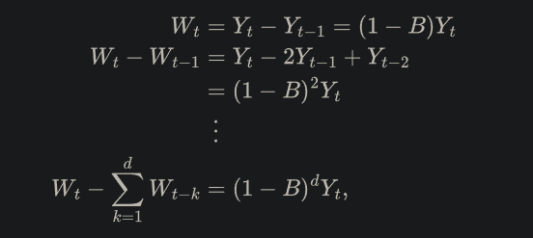
Mathematical Explanation of ARIMA
BTC Price Prediction
When time series exhibit nonstationary behavior (which commonly occurs in practice), then the ARMA model presented above can be extended and written using differences, which are defined as follows:
7

Slide 8
Mathematical Explanation of ARIMA
BTC Price Prediction
When time series exhibit nonstationary behavior (which commonly occurs in practice), then the ARMA model presented above can be extended and written using differences, which are defined as follows:
Where d is the order of differencing. Replacing Y_{t} in the ARMA model with the differences defined above yields the formal ARIMA(p,d,q) model:
8

Slide 9

Mathematical Explanation of ARIMA
BTC Price Prediction
So the Final form of the Mathematical form of the ARIMA(p,d,q) model developed from the ARMA(p,q) model is
9

Slide 10
Libraries:
BTC Price Prediction
yfinance
Pandas
Numpy
Math
Matplotlib
Sklearn
statsmodel
10

Slide 11
Dataset : ‘BTC-USD’
BTC Price Prediction
Features Present
Date – Data available on each date
Open - Open value of day
High - High value of day
Low - Low value of day
Close - Close value of day
Volume - Avg Value of BTC of day
11

Slide 12
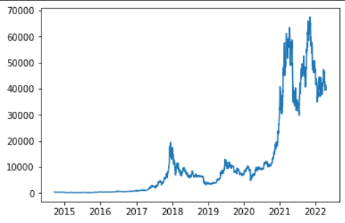
Dataset : ‘BTC-USD’ - Visualisation
BTC Price Prediction
12

Slide 13
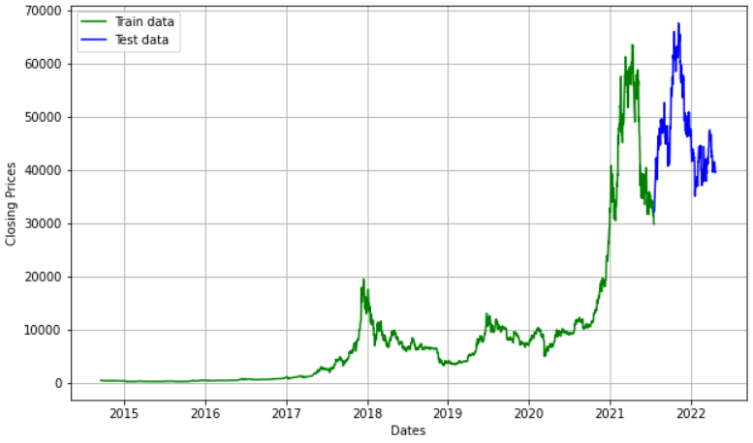
Dataset : ‘BTC-USD’ - Visualisation (Data Split)
BTC Price Prediction
13

Slide 14
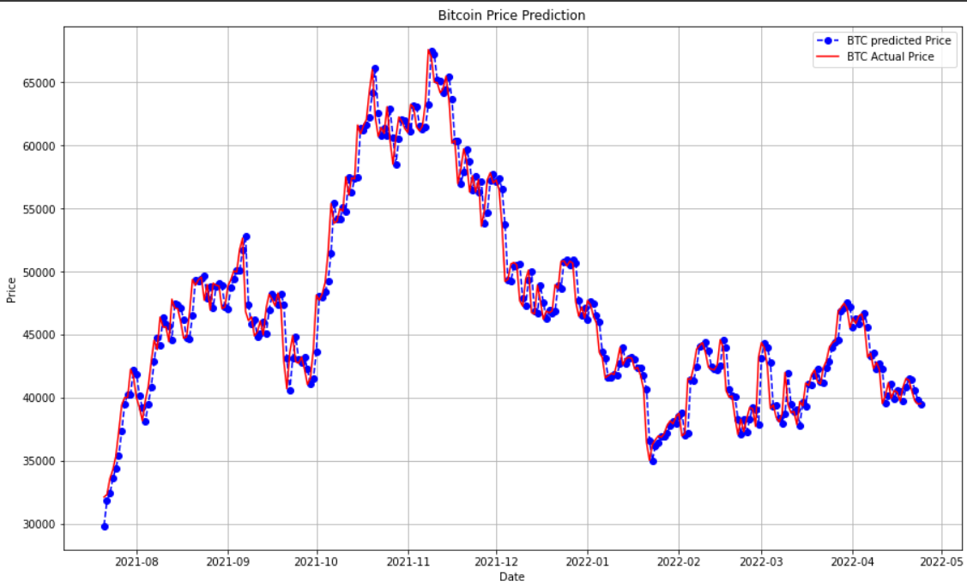
Dataset : ‘BTC-USD’ - Visualisation (Prediction)
BTC Price Prediction
14

Slide 15
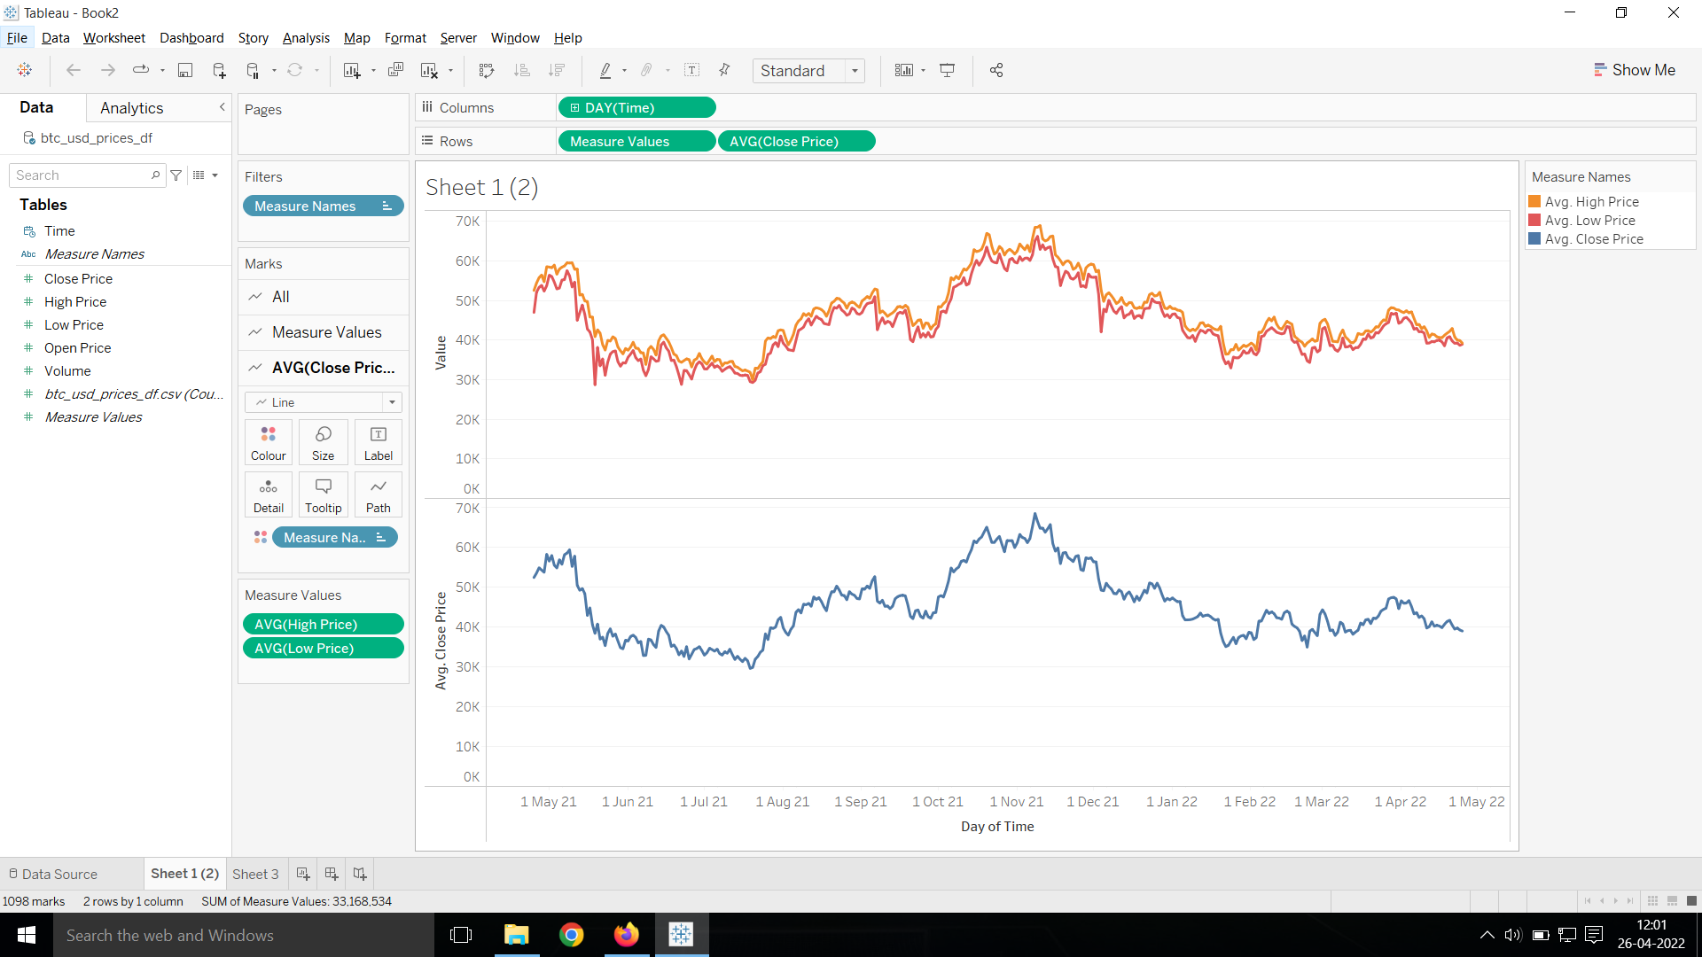
Tableau: Data Visualization
BTC Price Prediction
15

Slide 16
Model Evaluation (Accuracy)
BTC Price Prediction
Metrics used for Accuracy
Mean Absolute Percentage Error(MAPE):
MAPE is a statistical measure to define the accuracy of a machine learning algorithm on a particular dataset.
16

Slide 17
#Thanks
BTC Price Prediction
Any Question?
17

